Slide 1
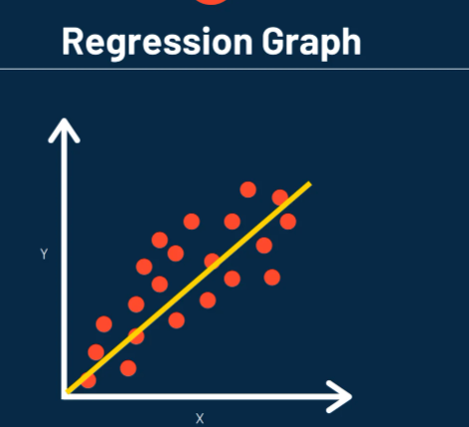
Introduction To Regression
Presenting By:-
Abhinav Penchala
Alisha Ali
Gayatri Gide
Kanagalakshmi M

Slide 2
What is Regression?
Definition:
Regression is a technique to find the relationship between two or more variables.
Purpose:
It helps predict one value (dependent variable) based on another (independent variable).

Slide 3
Key Terms in Regression
Dependent Variable (Y): What we want to predict.
Independent Variable (X): Input variable used for prediction.
Regression Line: A straight line that best fits the data.
Example:
Predicting house price (Y) based on size (X).

Slide 4
Types of Regression
Simple Linear Regression: One independent variable.
Multiple Linear Regression: More than one independent variable.
Logistic Regression: For categorical outcomes.
Other Types: Polynomial, Ridge, Lasso, etc.

Slide 5

Linear Regression
Definition: Models the relationship between one independent variable (X) and one dependent variable (Y).
Equation:
Example: Predicting house prices based on size.on size.
β0​: Intercept (value of Y when X=0).
β1​: Slope (change in Y unit change in X).

Slide 6

Multiple Regression
Definition: Extends linear regression by using multiple independent variables.
Equation:
Purpose: Captures the effect of multiple factors on the dependent variable.
Example: Predicting house prices based on size, location, and age of the property.

Slide 7

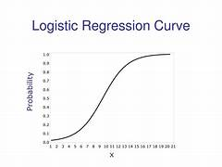
Logistic Regression
Definition: Used to predict categorical outcomes (e.g., yes/no, 0/1).
Models the probability of an event using a sigmoid function:
Example: Predicting whether a customer will buy a product (yes/no)..

Slide 8
Assumptions of Linear Regression
Linear Relationship: Between X and Y.
No Multicollinearity: Independent variables shouldn’t be highly correlated.
Homoscedasticity: Errors have constant variance.
Normality: Errors are normally distributed.

Slide 9
Advantages of Regression
Simple and interpretable.
Widely used for predictive modeling.
Can handle both continuous and categorical variables

Slide 10
Challenges of Regression
Multicollinearity: Independent variables are strongly correlated.
Overfitting: Too complex model fits noise instead of the trend.
Underfitting: Model is too simple to capture the pattern.

Slide 11
Why Learn Regression?
Applications:
Predict sales, stock prices, or weather.
Analyze trends and patterns.
Solve real-world problems.

